Slide 1







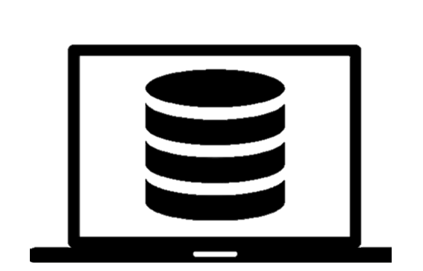



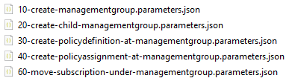
Tenant root scope deployment
Connect-AzAccount
Assign permission tenant root level
Azure/CET-NorthStar
Clone or Download
Validate and Deploy
(tenant level deployment)
Local machine
Modify ARM template/parameter files
…

Slide 2
Tenant root scope deployment
Connect-AzAccount
Assign permission tenant root level
Azure/CET-NorthStar
Clone or Download
Validate and Deploy
(tenant level deployment)
Local machine
Modify ARM template/parameter files
…

Slide 3





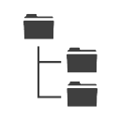

Initialize AzOps process
Azure/CET-NorthStar
Fork
<own GitHubID>/CET-NorthStar Private repository
Commit to master or feature branch
Setup GitHub secrets
Clone
Local machine
Setup root level permission
Import-Module
Initialize-AzOpsRepository
Local AzOps

Slide 4

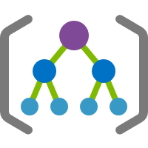



ARM deployment
ARM parameter file
location
policyDefinitonName
policyAssignmentName
roleDefinitionName
addressPrefix
firewallRules
managementGroupName
subscriptionGuid
costCenter
appKey
…
New-AzTenantDeployment
ARM template deployment scope
( / )
Tenant root scope
/providers/Microsoft.Resources/deployments
Management group scope
/providers/Microsoft.Management/managementGroups/{id}/providers/Microsoft.Resources/deployments
Azure Policy (deployIfNotExists)
Subscription scope
/subscriptions/{id}/providers/Microsoft.Resources/deployments
Resource Group scope
/subscriptions/{id}/resourceGroups/{name}/providers/Microsoft.Resources/deployments

Slide 5
Provision your own environment
Configure GitHub
Provision Platform
Create Landing Zones
Configure GitHub
Create initial MG structure
Discover environment
Initialize GitHub repository
Deploy definitions ‘YourCompany’ MG scope (Azure Policy, PolicySet, Role)
Create platform subscriptions
Azure Policy assignments
Platform Subscriptions
Landing Zone MG scope
Create Landing Zone (Subscription)

Slide 6

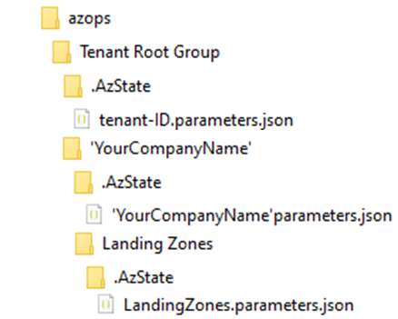



Deploy *Definitions
GitHub repo
‘YourCompanyName’ deployment scope
Update *Definitions in *.parameters.json
"properties": {
"policySetDefinitions": [],
"roleAssignments": [],
"policyAssignments": [],
"policyDefinitions": [],
"roleDefinitions": []
}
Push changes to feature branch
Pull Request to master
GitHub Actions

Slide 7
Deploy *Assignments
GitHub repo
Select deployment scope (→ any same or child scope from the definitions)
Update *assignments in *.parameters.json
"properties": {
"policySetDefinitions": [
{ definition }
],
"roleAssignments": [],
"policyAssignments": [],
"policyDefinitions": [
{ definition }
],
"roleDefinitions": [
{ definition }
]
}
Push changes to feature branch
Pull Request to master
GitHub Actions

Slide 8


Deploy *Assignments
Feature branch after initialization
Select deployment scope
Update *Assignments in *.parameters.json
Update *Definitions in *.parameters.json
"properties": {
"policySetDefinitions": null,
"roleAssignments": null,
"policyAssignments": null,
"policyDefinitions": null,
"roleDefinitions": null
}
"properties": {
"policySetDefinitions": null,
"roleAssignments": null,
"policyAssignments": null,
"policyDefinitions": null,
"roleDefinitions": null
}
*Definitions scope
*Assignments scope
,
Push changes to feature branch
,
Pull Request to master
GitHub Actions

Slide 9
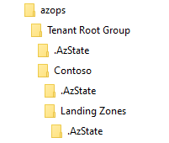

AzOps
Tenant Root Group
Contoso
Contoso
.AzState
Landing Zones
.AzState
LandingZones.parameters.json
Azure Policy (deployIfNotExists)
Subscription scope
/subscriptions/{id}/providers/Microsoft.Resources/deployments
Resource Group scope
/subscriptions/{id}/resourceGroups/{name}/providers/Microsoft.Resources/deployments

